Slide 1
Schema.org → ARC → FAIRagro Workflow
TA3/4 Retreat 2026
Notes:
Agricultural research data lives across dozens of repositories with different schemas, formats, and conventions. ARCs (Annotated Research Contexts) are the emerging standard for packaging that data, and FAIRagro's Search Hub is where researchers discover it. FAIRweaver's conversion pipeline bridges the gap: take metadata from any source, map it into an ARC, then extract the FAIRagro-specific schema for Search Hub ingestion.
The challenge is structural. Every ARC is a JSON-LD graph, and different research groups model the same domain concepts at different depths and in different graph locations. The pipeline must handle that variability — or define conventions to eliminate it.

Slide 2
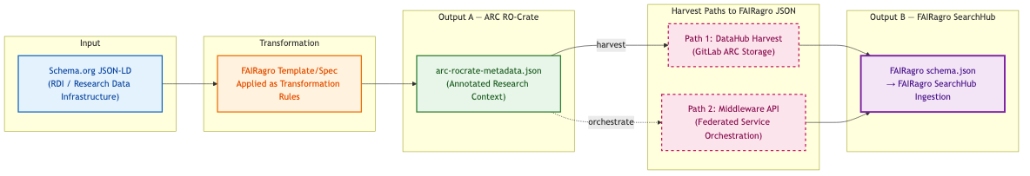
FAIRagro Metadata Transformation Pipeline
Key Points
Sequential dependency: Output B (FAIRagro JSON) is derived from Output A (ARC RO-Crate) — not a parallel output
Two harvest paths converge on the same FAIRagro JSON schema:
• Path 1 (solid): Direct harvest from GitLab DataHub where ARCs are stored
• Path 2 (dashed): Via FAIRagro Middleware API (federated service)
Both paths produce identical FAIRagro schema.json ingested into SearchHub
Notes:
The pipeline is strictly sequential. Schema.org JSON-LD from an RDI (Research Data Infrastructure) enters at the top, gets transformed by FAIRagro templates, and produces two outputs in order:
1. Output A — ARC RO-Crate. A JSON-LD document that follows the ARC specification.
2. Output B — FAIRagro JSON. Derived from Output A, not produced independently.
Output B's dependency on Output A is the key architectural insight. If the ARC is incomplete, the FAIRagro extraction is incomplete too. There is no shortcut.
Two paths feed the ARC into Search Hub:
- Path 1 (direct harvest): GitLab DataHub stores the ARC; a harvester reads it and produces FAIRagro JSON.
- Path 2 (orchestrated): The FAIRagro Middleware API coordinates the full workflow, from harvest through conversion to ingestion.
Both paths converge on the same FAIRagro schema.json consumed by Search Hub.

Slide 3
Three File Scenarios: Input → ARC → FAIRagro Output
Case | Input File | ARC Output | FAIRagro Output
Synthetic | schema-org-wheat-full.json | arc-ro-crate-wheat-full ✓ compliant | Full extraction ✓
Real — Small | arc-ro-crate-dronflyover.json (<10 MB) | Manual, partial ⚠ | Partial — mappable fields only
Real — Large | arc-ro-crate-muenchenberg-lte.json (>100 MB) | Manual, partial ⚠ | Basic harvest only
💡 If an ARC follows the FAIRagro specification → full metadata extraction. If not → only basic information is harvested.
Notes:
Three test files illustrate the relationship between ARC quality and extraction depth:
Synthetic (schema-org-wheat-full.json): A manually crafted input designed to cover every FAIRagro-required field. The resulting ARC is fully compliant; extraction gets everything. This proves the pipeline works when the input follows the rules.
Real — Small (arc-ro-crate-dronflyover.json, <10 MB): An actual agronomic ARC from the UC13 drone flyover. It follows the ISA Investigation → Study → Assay hierarchy but uses non-standard property names and missing optional fields. Result: partial extraction. Only fields that map unambiguously to the FAIRagro schema come through.
Real — Large (arc-ro-crate-muenchenberg-lte.json, >100 MB): A long-term experiment ARC from Müncheberg with 27+ assays but a flatter structure. Many domain-specific fields don't match any FAIRagro template key. Result: basic harvest only — title, description, identifier, creator.
The pattern is clear: compliance determines extraction depth. If an ARC follows the FAIRagro specification, you get full extraction. If not, you get the intersection of what's present and what's mappable. This is not a pipeline limitation — it's a signal that the community needs modeling conventions.

Slide 4
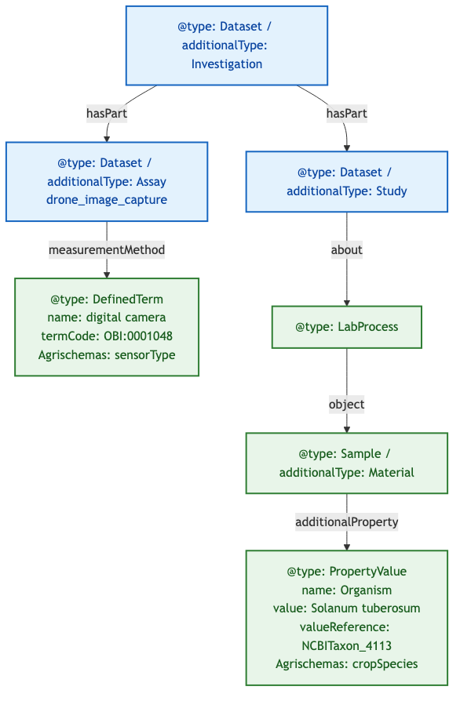
Examining ARC Structure: Domain Objects at Different Depths
Goal:
• Understand how Agrischemas concepts map into ARC RO-Crate
• Show that equivalent domain concepts require very different traversal depths
Example ARC RO-Crate: UC13 drone-flyover
Notes:
Two real ARCs, one problem: same domain concepts at different graph depths.
Drone Flyover (UC13):
Following the ISA hierarchy: Investigation → Study → Assay. Two Agrischemas concepts live at very different traversal depths:
- sensorType is 1 hop from Assay via measurementMethod → DefinedTerm.
- cropSpecies is 4 hops from Study via about → LabProcess → object → Sample → additionalProperty → PropertyValue.
The sensorType path is short and direct. The cropSpecies path requires traversing five nodes with specific predicates at each step. The parser must know the exact path — any deviation and it loses the concept.

Slide 5
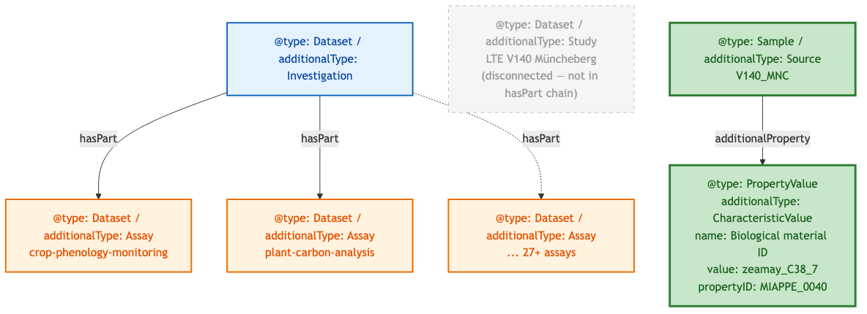
Müncheberg ARC: A Different Structural Pattern
Goal:
• Show another real ARC with a different structural pattern
• Reinforce that parser must handle multiple modeling conventions
Comparison: Drone Flyover vs Müncheberg
Aspect | Drone Flyover | Müncheberg LTE
Study entity | Explicit, in hasPart chain | Present but disconnected (not in hasPart)
Crop species path (short) | Study → LabProcess → Sample → PropertyValue (4 hops) | Source → additionalProperty → CharacteristicValue (2 hops)
Crop species path (long) | Same as short (only path) | ALSO via LabProcess → object → Source → additionalProperty
Sensor metadata | Present (DefinedTerm) | Absent
Assay count | 1 | 27+
Example ARC RO-Crate: Müncheberg LTE
Notes:
Müncheberg LTE:
A structurally different ARC. Investigation connects directly to 27+ Assays; a Study entity exists (studies/LTE-V140-Muencheberg/) but is NOT linked via the Investigation's hasPart chain. Crop species surfaces via a shorter alternative path: Source → additionalProperty → CharacteristicValue (2 hops instead of 4). Müncheberg also has the same long LabProcess chain as the drone flyover (via Study.about → LabProcess → object → Source → additionalProperty), so both paths coexist. Sensor metadata is absent because this ARC is about crop phenology, not remote sensing.
Comparison table:
- Drone Flyover: Study in hasPart chain, 4-hop crop path, 1 assay, has sensor
- Müncheberg LTE: Study disconnected, 2-hop + 4-hop crop paths, 27+ assays, no sensor
A generic parser cannot reliably extract crop species from both ARCs without knowing which structural pattern to apply. This variability is the core motivation for standardization.

Slide 6
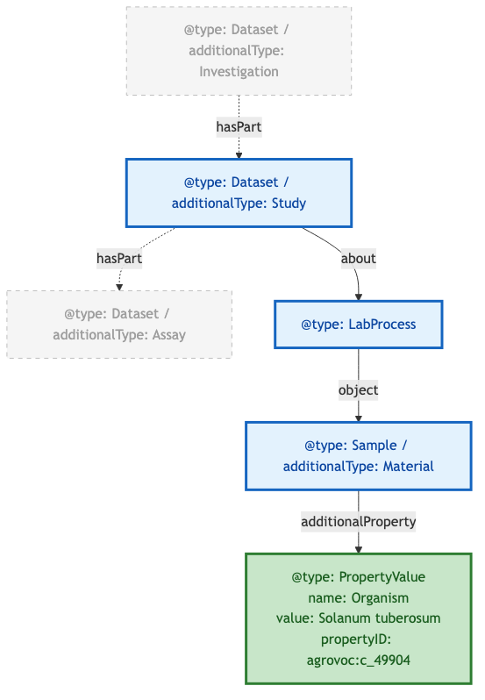
Required Modeling Pattern & Standardization Gap
Goal:
• Define the required path for unambiguous extraction
• Identify what still needs standardization
In bold: required objects/properties to represent Crop
Example ARC RO-Crate: UC13 drone-flyover
Open Questions
Question | Details
Structure: ? | How to formally specify the required traversal path?
propertyID: SSSOM mapping | How to standardize ontology term mappings?
Notes:
After examining both ARCs, a required traversal path emerges for unambiguous crop extraction:
Study → about → LabProcess → object → Sample/additionalType:Material
→ additionalProperty → PropertyValue/propertyID
The terminal node — PropertyValue with a propertyID — is critical. name: Organism and value: Solanum tuberosum are human-readable but machine-ambiguous. The propertyID linking to an ontology term (e.g., agrovoc:c_49904) makes it semantically precise and machine-resolvable.
Two open questions remain:
1. Structure specification. How do we formally specify a required graph traversal path so that tools can validate compliance automatically? A shape expression (ShEx) or SHACL shape? A simple property-path DSL in the pivot registry YAML?
2. Ontology mapping standardization. propertyID values need a shared vocabulary of mappings so that every ARC uses the same ontology term for 'crop species.' SSSOM (Simple Standard for Sharing Ontological Mappings) is a candidate — but it needs community adoption.
These are not FAIRweaver problems. They are community-level standardization problems that FAIRweaver exposes and quantifies.

